Slide 1
DARE Disability Access Route to Education
School Presentation 2024

Slide 2
Would
YOU
like to
go to college?
Where
would
YOU
like to go?

Slide 3
How do
I
get there?
How do
I
apply?

Slide 4
Have you
heard of
DARE?

Slide 5
Where can I go to college?
Dundalk Institute of Technology
ATU, Donegal
ATU, Sligo
St. Angela’s College, Sligo.
Maynooth University
Pontificial University
Dublin City University
Institute of Art, Design & Technology, Dún Laoghaire
Marino Institute of Education
NCAD
National College of Ireland
RCSI
Trinity College, Dublin
TU Dublin
University College Dublin
TUS, Athlone
ATU, Galway
University of Galway
SETU, Carlow and Wexford
Mary Immaculate College
University of Limerick
TUS, Limerick
SETU, Waterford
MTU, Kerry campus
MTU, Cork campus
University College Cork

Slide 6
Where can I go to college?
www.accesscollege.ie/dare/participating-colleges/

Slide 7
There is something for YOU
in college.

Slide 8
Arts…
Science…
Business…
Engineering…
Health Sciences…
Medicine…
IT…

Slide 9
Clubs & Societies…
Athletics…..Gaelic Football….
Mountaineering…..Drama….
Film….Dance…
Volunteer…Make a difference.

Slide 10
What is DARE?
The Disability Access Route to Education (DARE) is a third level alternative admissions scheme for school-leavers whose disabilities have had a negative impact on their second level education.
DARE offers reduced points places to school leavers who as a result of having a disability have experienced additional educational challenges in second level education.

Slide 11
Should I apply?
If your disability has had a negative impact on your educational performance in school.
You may not be able to meet the points for your preferred course due to the impact of your disability.
You are under 23 years of age as at 1 January 2024.

Slide 12
Disabilities eligible for consideration
Autistic Spectrum Disorder (including Asperger’s Syndrome)
ADD/ADHD
Blind/Vision Impaired
Deaf/Hard of Hearing
DCD – Dyspraxia
Dyslexia/Significant Literacy Difficulties
Dyscalculia/Significant Numeracy Difficulties
Mental Health Condition
Neurological Condition (Incl. Brain Injury & Epilepsy)
Physical Disability
Speech & Language Communication Disorder
Significant Ongoing Illness

Slide 13
DARE Eligibility Criteria
To be eligible for DARE you must meet both the DARE educational impact criteria and DARE evidence of disability criteria.
Applicants must provide the required evidence of their disability and provide an Educational Impact Statement from their school to be considered for DARE.

Slide 14
Educational Impact
Has your disability impacted on a combination of the following?
Have you received intervention or supports in post-primary school?
Has it impacted on your attendance or regularly disrupted your school day?
Has it affected your school experience and well-being?
Has it impacted on your learning or exam results?
Has it caused any other educational impact?
Required for applicants with Dyslexia/Significant Literacy Difficulties or Dyscalculia/Significant Numeracy Difficulties: is it severely impacting on your literacy or numeracy skills?

Slide 15
Benefits of DARE
Reduced Points
An example: If the Leaving Certificate points for a course are 366 points, an eligible DARE applicant could be offered a place with a lower points score e.g. 356 points.
Applicants need to meet entry and programme requirements to be considered for a DARE reduced points offer.
The amount of points a particular course is reduced by is dependent on:
The overall number of places on the course
The number of reserved DARE places on the course
The number of DARE eligible applicants competing for these reserved places.
The reduction in points for DARE places can vary every year.

Slide 16
Benefits of DARE
Orientation Programmes
Learning Support
Assistive Technology
Library Support
Exam Accommodations
Educational Support Worker
Academic Tuition
You don’t have to be eligible for DARE to get support in college.
A needs assessment is conducted to identify your specific support requirements.

Slide 17
How do I apply?
Apply to CAO at www.cao.ie by 1 February 2024.
Review your DARE Handbook with your parents or guardians.
Complete Section A of the Supplementary Info Form and apply to DARE by answering Yes to Question 1 by 1 March 2024.
You should start gathering your documentation in a timely fashion, i.e. before 15 February.
Submit the Educational Impact Statement and Evidence of Disability to CAO by 15 March 2024.

Slide 18
Supplementary Information Form (SIF)
Section A: Applicant Information
Completed by you online by 17:00 on 1 March 2024.
Answer Yes to Q1 to apply to DARE and fully complete Questions 1-5. OR
Answer Yes to Q1(b) to apply to carry forward your DARE eligibility.
Section B: Educational Impact Statement
Educational Impact Statement completed by your school. Send to CAO by 15 March 2024.
Section C: Evidence of a Disability
Completed by the appropriate professional. Send to CAO by 15 March 2024.
Section D: School Statement
Where applying under the Dyslexia/ Significant Literacy Difficulties category, applicants who do not have a Psychological Assessment Report identifying Dyslexia should submit Section D. Send to CAO by 15 March.

Slide 19
Section B: Educational Impact Statement
Provides information on how your disability has impacted on your second level education.
Download form.
Complete the Educational Impact Statement (EIS) Checklist with your school.
Your school will complete the rest following on from your responses to the EIS Checklist.

Slide 20
Section B: Educational Impact Statement
This form needs to be completed by either your:
Guidance Counsellor
Learning Support Teacher
Year Head
Visiting Teacher or
Principal/Deputy Principal
The form MUST BE signed and stamped by school Principal/Deputy Principal.
You must return to the CAO by 15 March 2024.

Slide 21
Section C: Evidence of Disability
Provides verification of your disability and helps to determine 3rd level supports.
You can provide an existing report OR
Complete Section C Evidence of Disability Form 2024.
Get the form completed, signed and stamped by the appropriate professional or accompanied by their business card or headed paper.
Applicants with Dyslexia/Significant Literacy Difficulties or Dyscalculia/Significant Numeracy Difficulties are asked to provide a full psychological assessment of any age completed by an appropriately qualified psychologist instead of the Section C Evidence of Disability form. Where applying under the Dyslexia/ Significant Literacy Difficulties category, applicants who do not have a Psychological Assessment Report identifying Dyslexia should submit Section D.
GP Verification
Your GP may be in a position to complete Section C Evidence of Disability, if they have the appropriate information on file from the Consultant/Specialist.

Slide 22
Section C: Evidence of Disability
Age of Reports
It is important to note that applicants applying under the following disability categories must provide a report that is less than 3 years old, i.e. dated after 1 February 2021.
ADD/ADHD
Mental Health Condition
Significant Ongoing Illness

Slide 23
Section C: Evidence of Disability
Psychological Assessment
Applicants with Dyslexia/Significant Literacy Difficulties or Dyscalculia/Significant Numeracy Difficulties must provide a full Psychological Assessment Report of any age completed by a psychologist.
Where applying under the Dyslexia/ Significant Literacy Difficulties category, applicants who do not have a Psychological Assessment Report identifying Dyslexia should submit Section D: School Statement in support of their application.
AND
Applicants with Dyslexia/Significant Literacy Difficulties MUST also have two literacy attainment scores at or below the 10th percentile (Standard Score of 81 or below).
Applicants with Dyscalculia/Significant Numeracy Difficulties MUST also have one numeracy attainment score at or below the 10th percentile (Standard Score of 81 or below).

Slide 24
Section C: Evidence of Disability
Continued.
These attainment scores can be from one (or a combination) of the following sources:
1) Scores from school-based attainment testing
2) Scores from attainment tests carried out by a psychologist.
Testing must have been carried out after 1 February 2022 and all applicants must submit an EIS completed by their school.

Slide 25
Section C: Evidence of Disability
Check out the information on providing evidence of your disability on
www.accesscollege.ie/dare/providing-evidence-of-your-disability
You must post Evidence of Disability documentation to the CAO by 15 March 2024.
Please keep a copy of all documents that you post to CAO.

Slide 26
Section D: School Statement
If you are applying under the Dyslexia / Significant Literacy Difficulties Category but you do NOT have a Psychological Assessment Report identifying Dyslexia, then
Submit section D: School Statement.
Ensure that this is signed and stamped by the appropriate staff at your school.
http://accesscollege.ie/dare/making-an-application/handbooks-forms/
You must post Section D to the CAO by 15 March 2024.

Slide 27
Helpful Tips
Study the DARE Handbook carefully with your parents / guardians.
Select Yes to Question 1 on the SIF before 5pm on 1 March.
Ensure you speak to your Teacher early about the Educational Impact Statement.
Request the required supporting documentation early.
Send good quality copies of all pages of the correct documents.
Submit all supporting documents requested by 15 March.
Keep proof of postage.
Deadlines!

Slide 28
Common Mistakes that affect DARE Eligibility
Where the Section C form (Evidence of Disability) is completed by GP BUT the required copy of report by appropriate professional confirming diagnosis was not provided.
Reports out of date
Reports not confirming diagnosis of condition by consultant
Incorrect professional completing Section C form or Evidence of Disability Report
Test details missing (for example the name of the test, date or who conducted the test)
Forgetting to complete Question 1 of the Supplementary Information Form by 17:00 on 1 March

Slide 29
Applying for a grant
DARE is NOT
the SUSI grant.
.
If you apply to DARE ,
you should also apply to SUSI
if you think you may be eligible.

Slide 30
SUSI: Key Eligibility Criteria
Nationality: Irish, EU, EEA, Swiss nationals or have specific leave to remain in the State.
Residency: 3 of last 5 years in Ireland, EU, EEA or Switzerland.
Progression in education – NFQ levels 5-10.
Approved College/Course
‘Reckonable’ Income (Class - Dependent/Independent) www.susi.ie/undergraduate-income-threshold-and-grant-award-rates/

Slide 31
SUSI: Key Eligibility Criteria
Check the website: www.susi.ie (Use Eligibility Reckoner)
CAO form: Tick the SUSI option to share your college acceptance
Apply early: April 2024
Return requested documentation: complete and on time
Website: www.susi.ie
Email: support@susi.ie
Facebook.com/susisupport
Twitter.com/susihelpdesk
Telephone helpdesk: 0818 888 777
Contact SUSI

Slide 32
DARE and HEAR Timelines
DARE & HEAR closing date |  | 1 March 2024 at 17:00
Supporting documents closing date |  | 15 March 2024
Notification of eligibility |  | Late June 2024
Review and Appeals Application |  | Early July 2024
HEAR/DARE offers |  | August 2024
College Orientation |  | Late Aug /Early Sept 2024

Slide 33
Remember
Submit it!
Check it!
Send it!

Slide 34
Remember
You can apply to both DARE & HEAR
Applicants who are both DARE and HEAR eligible will be prioritised by colleges when allocating reduced points places.

Slide 35
Further Information: www.accesscollege.ie

Slide 36
Virtual Application Information Days
Saturday
13 January
2024
10am -2pm

Slide 37
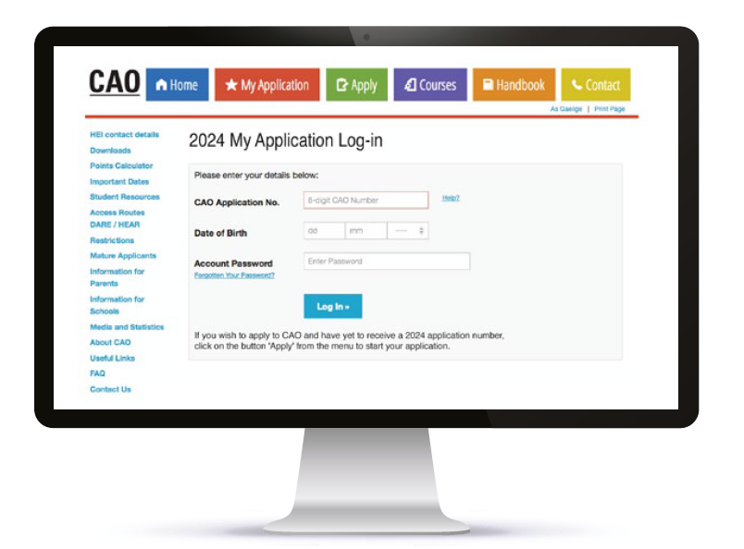
DARE Application Outcome
You will receive an email notification about your DARE application outcome once the Leaving Certificate examinations are over in late June.
Log into your CAO application to view your
DARE Application Outcome.

Slide 38
Further Information
cao.ie
susi.ie
qualifax.ie

Slide 39
Follow us on….
www.accesscollege.ie

